Slide 1


ABDELGHAFOR’S HACKATHON
CAUSES OF
DEA*H

Slide 2

Agenda
1.Introduction
2.Data Overview
3.Data Cleaning & Pre-Processing
4.Tools & Visualizations
5.Summary Statistics
6.Recommendations & Future Work

Slide 3


Slide 4

Causes Of Deaths
will be analyzed in this presentation using a dataset across various countries and Diseases,
utilizing analytical skills to extract meaningful insights.
The goal is to highlight critical trends that can help nations identify and address health risks,
effectively spotting our blind spots, By pointing these key factors, we aim to raise awareness and promote proactive measures for disease prevention.

Slide 5

OVERVIEW

Slide 6

Causes Of Deaths
Our Dataset has Some Columns....
Country : Identify Country Name ( 204 Country) .
Code : The Abbreviation of the Country.
Year : Will be from 1990 to 2019, for each Country.
Group Of Columns With Diseases Names.
Finally, The cells represent the number of deaths
Caused by specific Diseases within each Country for a given Year.
So, The Row Implement Only One Year in One Country.

Slide 7



BRAINST RM
Here,
We Start Creating our Questions to be Answered in our Dataset.
What We Need From it !!
What we have to Achieve ?!
Why !
and here you can find our Brainstorming ....

Slide 8

LET'S CLEAN

Slide 9

DATA CLEANING
No Null Values
No Duplicated Rows

Slide 10

DATA PRE-PROCESSING

Slide 11
NOW,
WE START TRANSFORMING OUR DATASET WITH VARIOUS WAYS.
Python
Excel and Power BI
Clustering Diseases in
Some Categories.
Get The Unique Vales.
Calculate
the total deaths in
each year,
each country
and for each disease.
Prepare some variables to facilitate filtering,
Clustering Diseases in
Some Categories in new Columns.
Calculate
the total deaths in
each year and for each country in another Column.
Add a new Row called Worldwide,
to Sum all deaths over the world for each disease.
Used a new Column to calculate Growth Rate in each country.
Finally, Sent the Xlsx file to python to reshape it.

Slide 12

TOOLS & VISUALIZATIONS

Slide 13



PYTHON
POWER BI
EXCEL

Slide 14
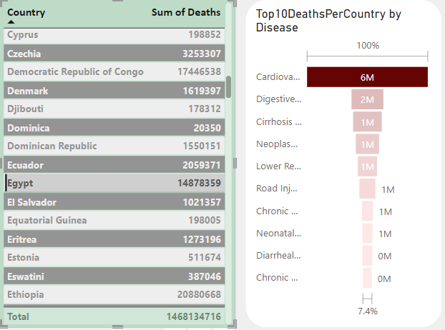
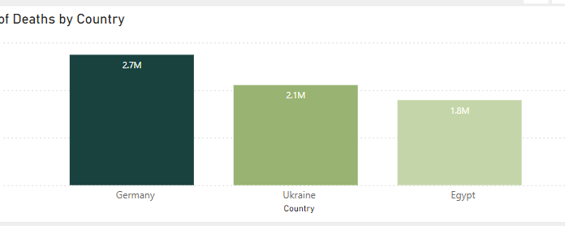
VISUALIZATIONS
To effectively communicate our findings, we employed carefully
selected visualizations tailored to the nature of our data,
ensuring clear representation of trends, patterns, and key insights.
These visual tools provide a comprehensive view, making it easier to understand and actionable.
Detects Top 10 Diseases
In Specific Country in Range of Years
Found that Globally :
China is the Highest Country in Deaths.
Tokelau is the Lowest Country in Deaths.
Comparing Countries Deaths
from Specific Range of Years

Slide 15
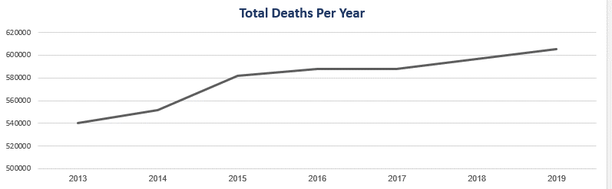
VISUALIZATIONS
Line Chart for Continuous Type ( Date )
Showing Increasing and Decreasing Deaths in Specific Range
in Chosen Country ( Egypt )

Slide 16
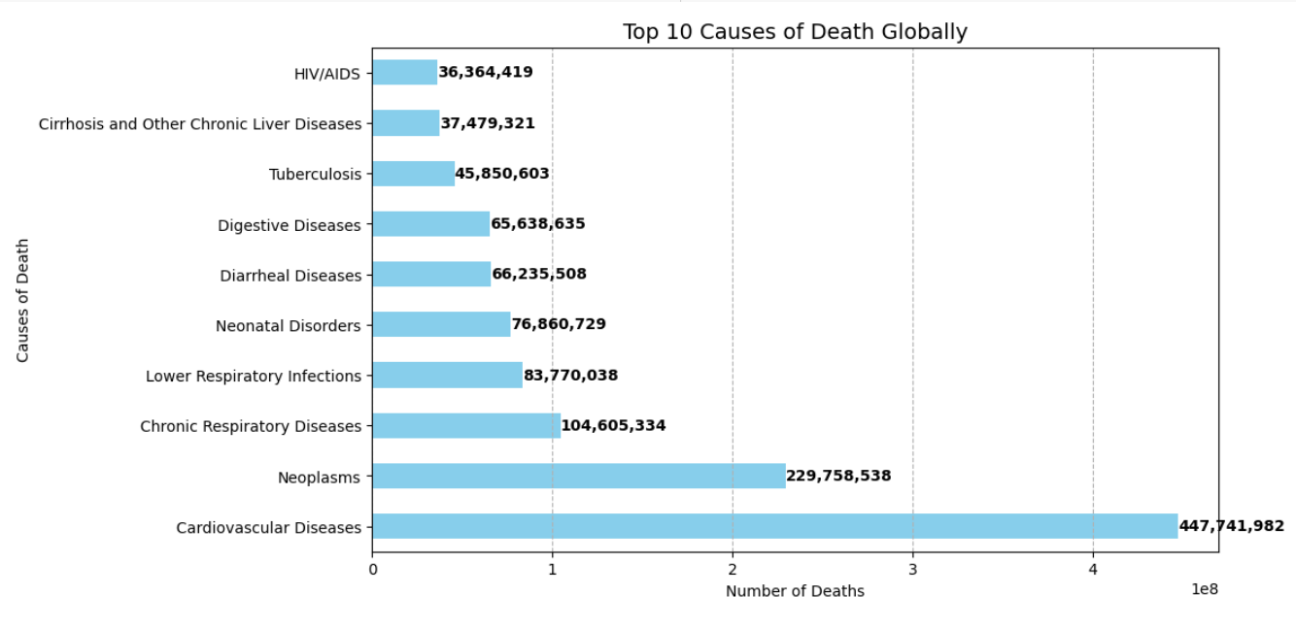
VISUALIZATIONS

Slide 17
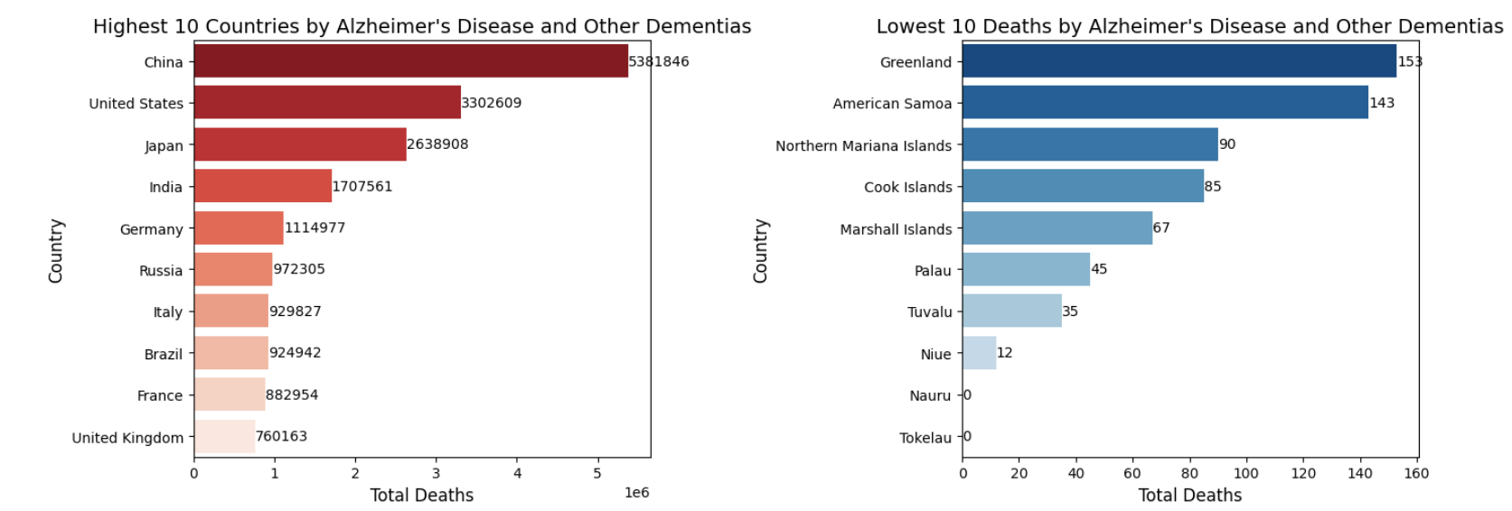
VISUALIZATIONS

Slide 18
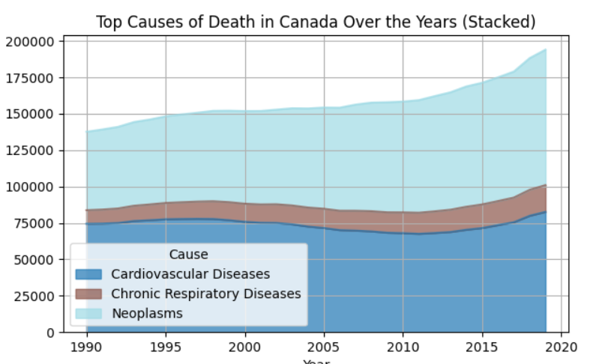
VISUALIZATIONS

Slide 19


Slide 20

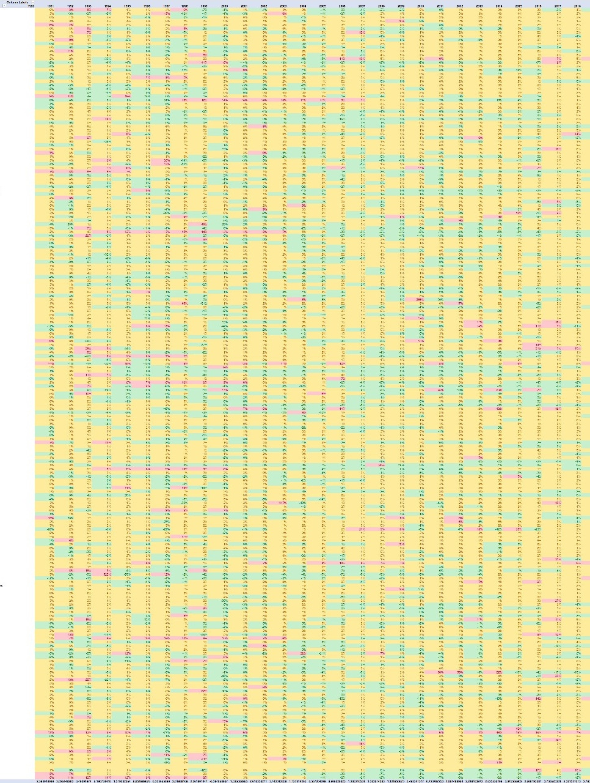
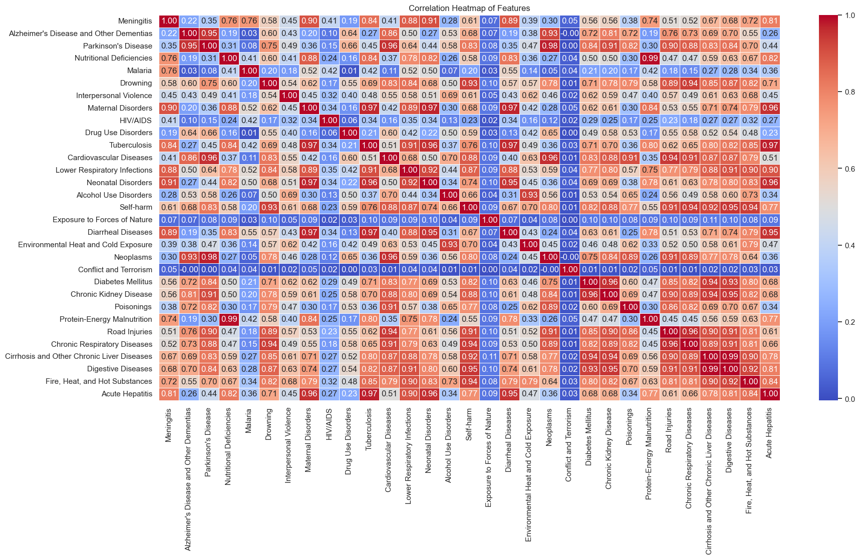
STATISTICS
Helpful Insights,
We got a Growth Rate for each Country, to specify
the Increasing or Decreasing of Deaths.
Helped us to detect Some Outliers
and Start Getting the reasongs for
the Huge Numbering by historical data.
Another one in python, that Got the Correlation between each disease
and all other diseases,
So we can Check if there are Links
between some disaeses
LET'S GET EXAMPLES

Slide 21
HERE IS THE POWER OF ANALYTICS
Here We can detect that in
Rwanda,
There was a Growth Rate increased to 522% as the year before !!
and it was -9% the last one, Surely there is a Problem Here that Made that !!
Went to check in which year had happened, It was 1994 .....
YOU CAN CHECK
WHAT HAD BEEN HAPPENED THERE !!

Slide 22
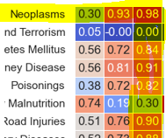
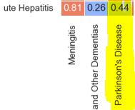
ANOTHER ONE !!
Here We can See From the Correlation table, That there is a
high relation between
Neoplasms & Parkinson’s Diseases ...
Although that Medical Information tell us that is no relation between them,
But The Analytics Tell Something else !!

Slide 23

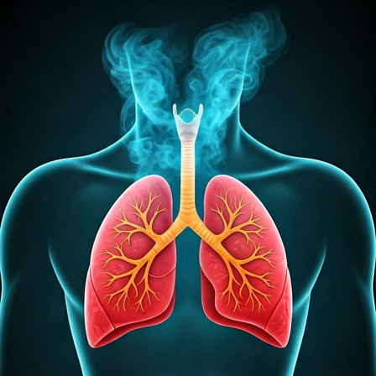
AT THE END OF OUR JOURNEY
I am Delighted to share these Recommendations
The Data shows that many Countries has an increasing rate into deaths
So, We can Take a step to collect reasons and prevent Diseases from
taking our Dears.
Medical Staff can Mainly use this info to start taking some actions.
Like
Helping Egypt from Digestive Diseases.
Helping Germany from Neoplasms.
Globally, from Cardiovascular Diseases.

Slide 24

FUTURE WORK
IS TO GET THE POPULATION FOR EACH COUNTRY
TO CALCULATE THE PERCENTAGE OF DEATHS IN EACH ONE
IT WILL HELP US TO PROVIDE A POWERFUL UNDERSTANDING OF
HOW MANY LIVES ARE LOST EACH YEAR,
HELPING TO UNDERSCORE THE URGENT NEED FOR AWARENESS
AND PREVENTATIVE ACTION.

Slide 25
ABDELGHAFOR’S HACKATHON
THANK
YOU

